Slide 1
Experiments
(samples)
gene A | 0.1 | 0.8 | 0.3 | 0.4
gene B | 2.2 | 0.2 | 0.9 | 0.8
gene C | 1.2 | 0.1 | 0.8 | 0.7
gene D | 0.3 | 0.9 | 0.2 | 0.3
gene E | 0.2 | 0.5 | 0.3 | 0.5
gene F | 0.4 | 0.7 | 0.3 | 0.2
Genes

Slide 2
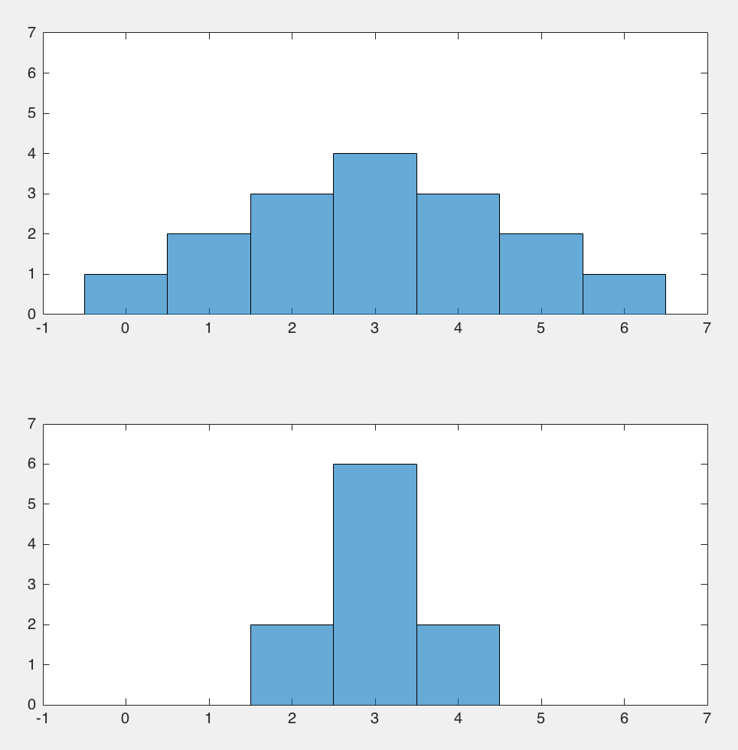
mean
variance
variance

Slide 3
Alternative coordinate systems
y
y
y'
x'
x
x
a)
b)

Slide 4
control5
control2
case1
case3
case5
case4
case6
case2
case7
control3
control6
control7
control1
control4

